Slide 1
EE 66
Voice Recognition
Welcome! We’ll be starting at Berkeley Time.

Slide 2
Semester Outline
Shazam
Acoustic Positioning
Voice
Recognition
Image Deconvolution
Medical Imaging

Slide 3
Today’s Agenda
Voice Classification Problem Overview
SVD / PCA Conceptual Review
Using SVD / PCA for Voice Classification
Tips for Best Performance

Slide 4
Voice Recognition Problem
Have:
  Set of words
  40 recordings of someone speaking each word
Want:
  A model that can be given a new recording (audio signal) of the spoken word and predict which word it is!
In other words, given a training dataset, “train” a classifier model that takes audio signals
  Machine Learning!

Slide 5
Voice Classification Solution
Our voice classification system:
Data Pre-Processing
SVD and PCA
Centroid Classification
Validation

Slide 6
Voice Classification Solution
Our voice classification system:
Data Pre-Processing
SVD and PCA
Centroid Classification
Validation

Slide 7
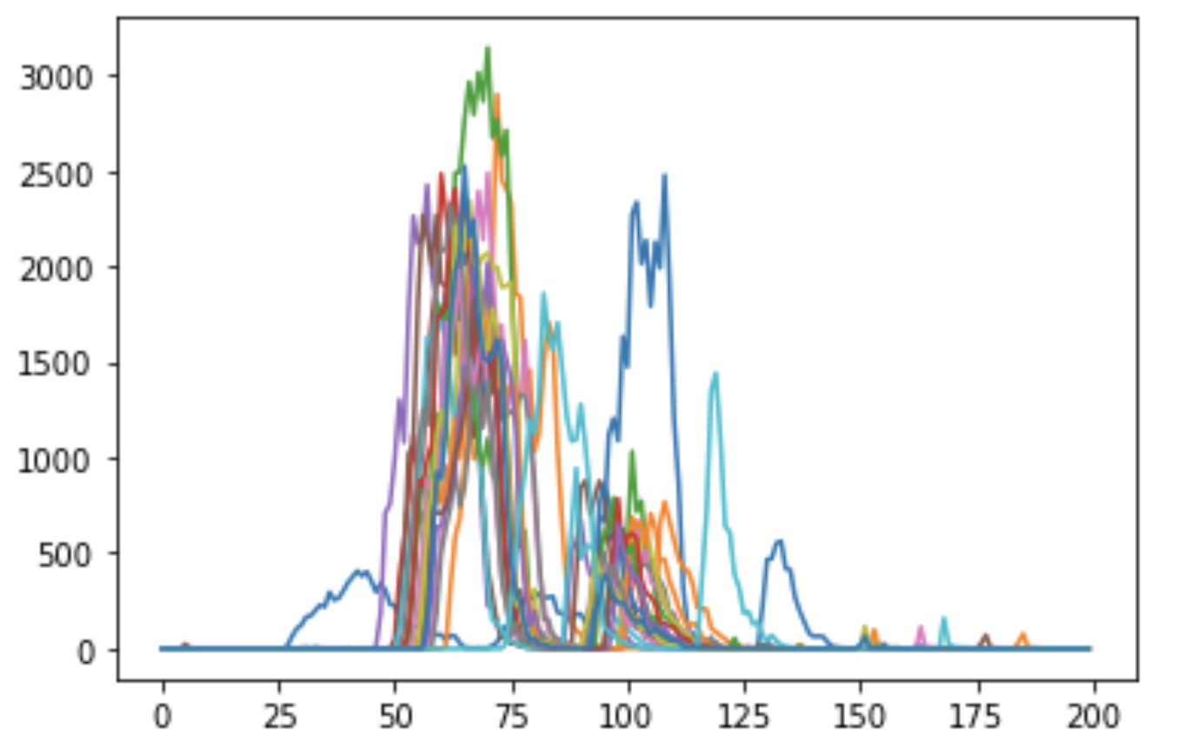
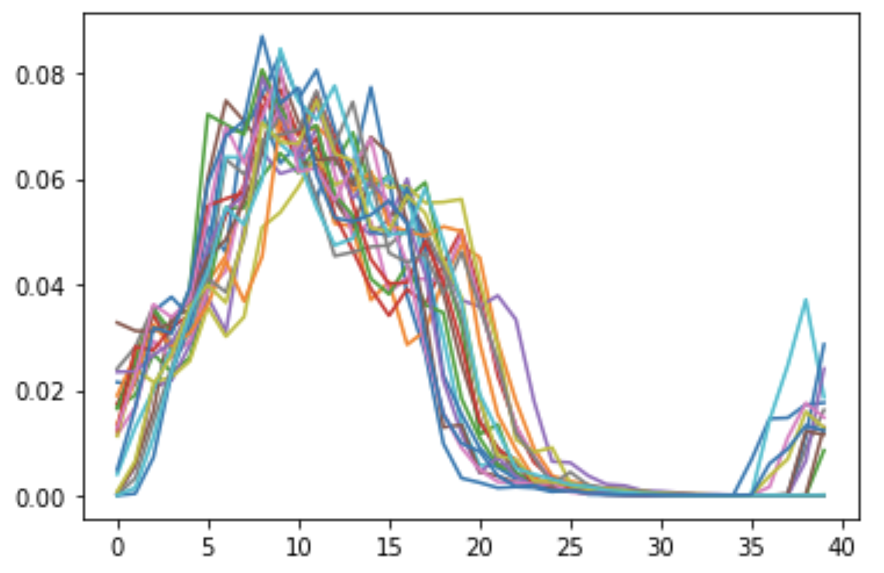
Data Preprocessing/Word Alignment
Trim and align each recording to locate and isolate the spoken word
  Threshold - percentage of the max value needed to trigger a word start
  Pre-length - how many samples before we hit the threshold did we start speaking the word
  Length - how many samples long the recording is
Word example: “meat”

Slide 8
Voice Classification Solution
Our voice classification system:
Data Pre-Processing
SVD and PCA
Centroid Classification
Validation

Slide 9
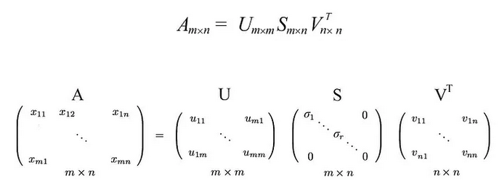
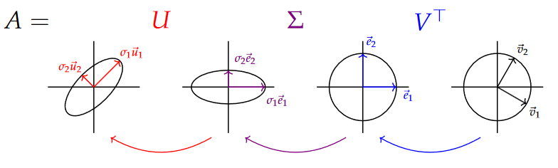
Singular Value Decomposition (SVD)
What is SVD?
  Decompose a matrix into 3 separate matrices with unique properties
U
  Orthonormal eigenvectors of AA^{T}
  A rotation matrix!
S
  Diagonal matrix of singular values
  Think of as a scaling matrix!
V
  Orthonormal eigenvectors of A^{T}A
  Another rotation matrix!
Notes:
The SVD decomposition breaks down any linear transformation ⁠into a composition of three geometrical transformations: a rotation or reflection, followed by a coordinate-by-coordinate scaling, followed by another rotation or reflection.

Slide 10
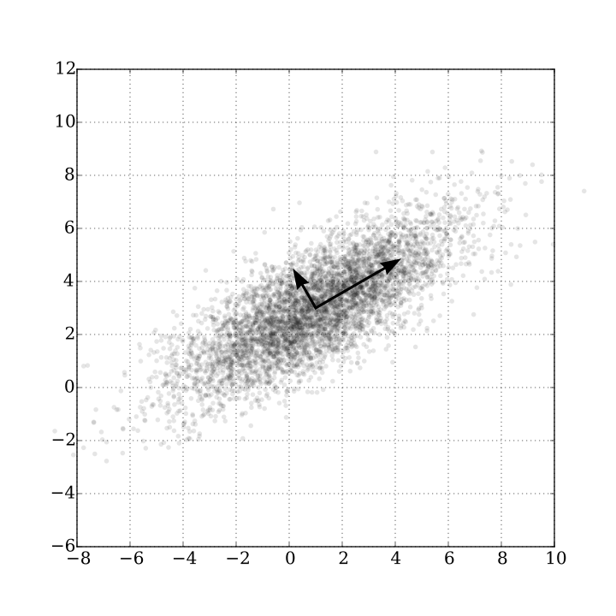
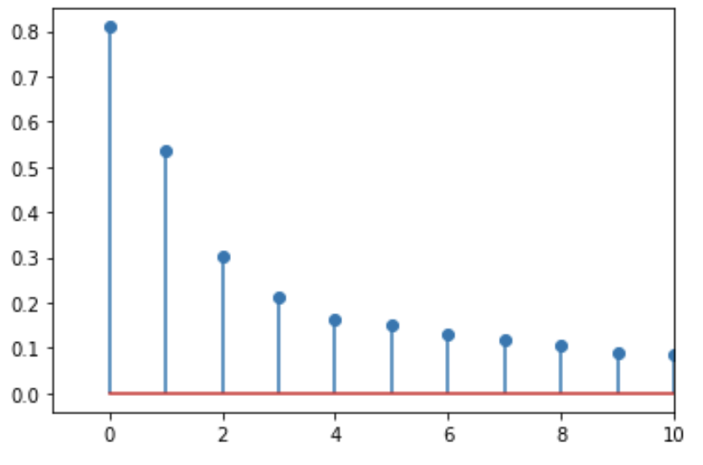
Principal Components Analysis (PCA)
PCA = Principal Component Analysis
  Principal components: basis vectors that maximize variance in our data
  Oftentimes, we can capture most of the data’s behavior with just a few principal components!
    Fewer dimensions is easier to work with
How do we compute PCA?
  Let’s use SVD!!!!
  Take the vectors that correspond with the highest singular values since those are the “most important” transformations of a matrix
  The principal components of our setup are the column vectors from V
Principal Components of Data Example
Sigma Values Example
Notes:
PCA linearly transforms the data onto a new coordinate system such that the directions (principal components) capturing the largest variation in the data can be easily identified.

Slide 11
Organization of our Data
Each recording is a vector of some numbers that represent our sampled audio signal
Given our data, what can we do to classify a new recording? What are some features that we can compare?
Recording 0 = [-64, 30, 24, 52, …]
Recording 1 = [-54, 86, 78, 64, …]
Recording 2 = [32, 64, 50, -110 …]
Recording 3 = [-40, 70, 4, -36, …]
…

Slide 12
Features
Stack all the recordings into a matrix
  Each row is a recording
  Each column is an audio sample
Audio samples are used as features - how to distinguish one datapoint from another
feature
0
1
2
3
Recording 0 = [-64, 30, 24, 52, …]
Recording 1 = [-54, 86, 78, 64, …]
Recording 2 = [ 32, 64, 50, -110 …]
Recording 3 = [-40, 70, 4, -36, …]
…

Slide 13
Computing PCA via SVD
Split our data into (70%) training and (30%) testing data
  Use training data for the steps below, save testing data
Stack the aligned words in a data matrix
Zero-mean (“demean”) the data using the mean of each timestep (each “feature”) in preparation for SVD
word1_processed_train
word2_processed_train
demeaned_A =
mean(processed_A)
word3_processed_train
word4_processed_train
processed_A

Slide 14
Voice Classification Solution
Our voice classification system:
Data Pre-Processing
SVD and PCA
Centroid Classification
Validation

Slide 15
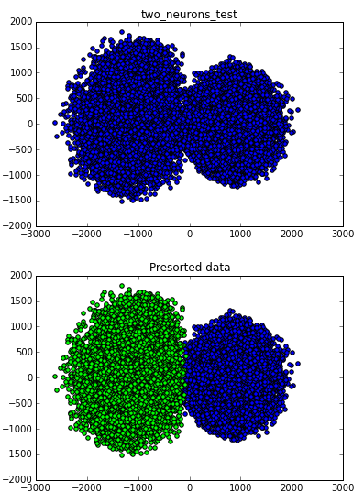
Centroid Classification
We now have:
  Labelled training data (70% of Original Data)
  Axes of most variation (PCA basis vectors)
Project data onto basis vectors
Find projected centroid (mean) for each word
  To classify new points (unlabelled data), project it onto these basis vectors and finding which centroid it is closest to
Notes:
Find the center of each cluster by taking the mean of all points in a cluster

Slide 16
Voice Classification Solution
Our voice classification system:
Data Pre-Processing
SVD and PCA
Centroid Classification
Validation

Slide 17
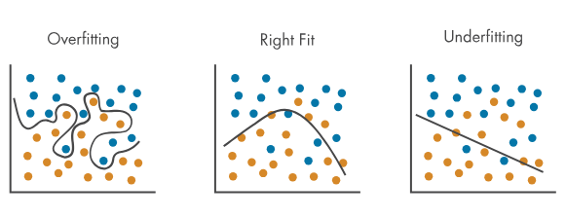
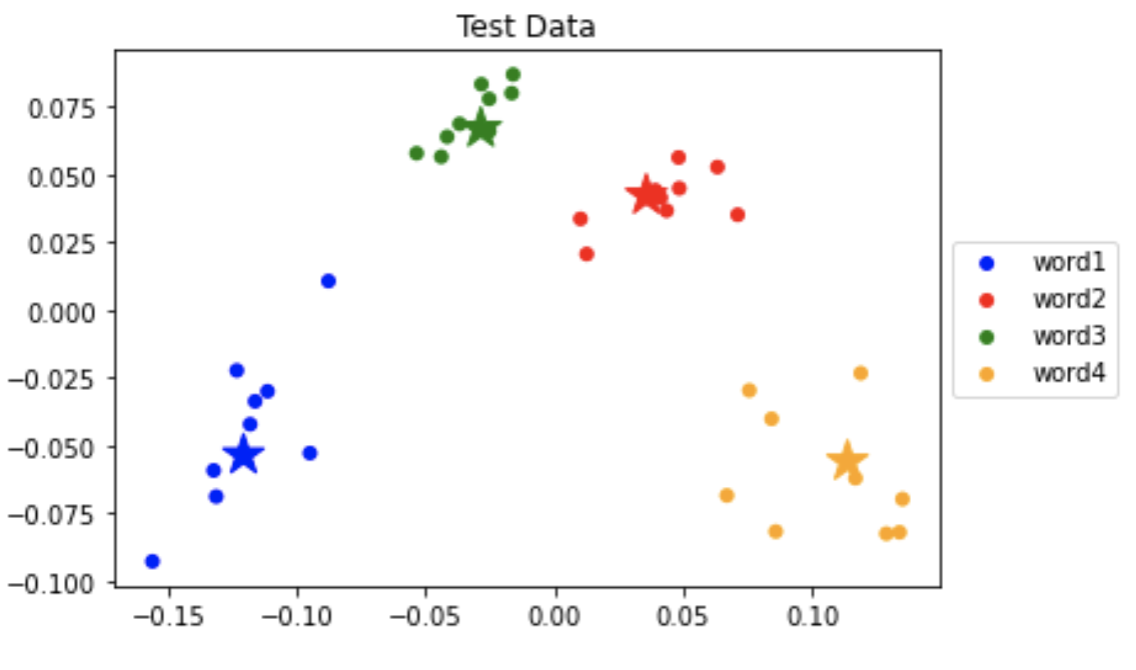
Verify your Classifier
Using the 30% of data set aside, verify the accuracy of our classifier
  Project test data onto our PCA vectors
  Subtract projected mean vector
  Assign to closest centroid in 3D space
  Check if classified centroid is the same as the data label
Aim for at least 80% accuracy on all words with the test data!
  In machine learning, it is standard practice to follow this “set aside” method to verify that the classification works and isn’t overfitting

Slide 18
Word Dataset Guidelines
Speech pattern recognition, not word recognition
  Actual word doesn’t matter, but the speech pattern for the word does!
  Enunciate syllables well to make clear distinctions
Generally, we try to use words with:
  Different syllables (e.g. pear, apple, banana, watermelon)
  Different endings (hard vs. soft, , e.g back vs. shoe)

Slide 19
Data Collection Guidelines
We will provide 4 word datasets
[Optional] You can collect 40 recordings of one word of your choosing, making the total 5 words
PLEASE SAVE YOUR NOTEBOOK AND RECORDINGS WHEN YOU’RE DONE! YOU WILL NEED IT FOR NEXT WEEK (save entire folder as .zip and send to yourself / save to Google Drive)

Slide 20
Checking-off Today
You must test your voice classifier in Cory 111 (Task 6)
Follow the directions linked at bottom of the lab
  Fill out Google form
  Station number: Sit at a lab computer and enter the number ## on the monitor (c111-##)
During checkoff:
  You will be asked a series of conceptual questions. Make sure you fully understand what is going on.
  If you want to add songs to our playlist: tinyurl.com/66-playlist

Slide 21
Lab Computer Setup
CAN WORK IN PARTNERS.
Download the “Zip” file on the EE 66 website
Extract the files from the zip folder
Open the “Launch Marimo” script inside the vr1 folder

